Slide 1
Advanced Image Analysis
2017-2018, 2nd semester
Introduction to OpenCV
Alessandro Bria
Contract Professor
and Post-doc Researcher
email: a.bria@unicas.it

Slide 2

Overview
Open source Computer Vision (Intel, 1999) is a library written in C/C++ mainly aimed at real-time computer vision
free, open-source and cross-platform
fast
widely considered the fastest image processing and analysis library available
faster than ITK, which is more focused on medical images
simple to use
MATLAB-style functions, few templates (unlike ITK), good documentation

Slide 3
Modules (1/2)
how to include a module:
#include <opencv2/core/core.hpp>
core
basic data structures, including cv::Mat used to represent multi-dimensional images
imgproc
image processing, (non)linear filtering, geometric transformations (resize, affine, warping), color space conversions, histograms, ...
highgui
UI capabilities, video capturing, image and video codecs.
feature2D
salient feature detectors, descriptors, and descriptor matchers.

Slide 4
Modules (2/2)
video
motion estimation, background subtraction, object tracking, ...
objdetect
detection of objects and instances of the predefined classes (faces, eyes, cars, ...)
calib3d
camera calibration, object pose estimation, 3D reconstruction, ...
stitching
image stitching
ml
machine learning: Boosting, Decision Trees, EM, K-Nearest Neighbor, Naive Bayes, Neural Networks, Random Forests, Support Vector Machines, Deep Neural Networks (OpenCV 3)

Slide 5
Basic Concepts (1/2)
namespace
all classes and functions are placed into the cv:: namespace
in Visual Studio, start typing cv:: and the full list of classes/functions will be displayed
automatic memory management
no need to manually allocate/deallocate memory to store image data
image data are shared among utilizers and automatically deallocated when not used anymore
saturation arithmetics
values outside the range corresponding to the image type (e.g. 0-255 for 8-bit images) will be saturated to the nearest boundary value (e.g. 270 --> 255, -10 --> 0)
error handling
critical errors are signaled by throwing a cv::Exception, which can be captured in a try-catch block

Slide 6
Basic Concepts (2/2)
fixed pixel types
since there are no templates (unlike ITK), there is a limited fixed set of primitive data types the library can operate on:
8-bit unsigned integer (unsigned char) values in [0,255] code: CV_8U
16-bit unsigned integer (unsigned short) values in [0,65535] code: CV_16U
32-bit unsigned integer (unsigned int) values in [0, 4294967295] code: CV_32U
8-bit signed integer (char) values in [-128,127] code: CV_8S
16-bit signed integer (short) values in [-32768,32767] code: CV_16S
32-bit signed integer (int) values in [-2147483648, 2147483647] code: CV_32S
32-bit floating-point (float) single precision code: CV_32F
64-bit floating-point (float) double precision code: CV_64F

Slide 7
The cv::Mat data structure

Slide 8
Basic object members
basic object members (let us suppose we have defined a cv::Mat aMat object)
aMat.rows the number of rows / height (2D matrices only)
aMat.cols the number of columns/ width (2D matrices only)
aMat.dims the matrix dimensionality (=2 for 2D matrices)
aMat.size[i] the size along the i-th dimension
aMat.channels() the number of channels
aMat.depth() pixel type (CV_8U, CV_16U, CV_32F, ...)
you can use the utility function aia::bitdepth() to transform the OpenCV depth code into the actual number of bits used (bitdepth)
aMat.data pointer to raw data
this member is often used to check whether the image has been correctly loaded, e.g.:
if(!aMat.data)
throw aia::error("Cannot load image");

Slide 9

Basic object methods (1/3)
basic object methods
cv::Mat anotherMat = aMat.clone()
returns a deep copy of the object, i.e. the data is cloned (new memory needed)
from now on, aMat and anotherMat are two different entities, i.e. modifying one will not affect the other. If we had simply done anotherMat = aMat, this would have resulted in a shallow copy, i.e. modifying one does affect the other!
aMat.convertTo(cv::Mat output, int pixel_type)
converts to a different pixel type; output can be aMat itself or another object
saturation arithmetics is applied, i.e. if aMat stores values in [0,65535] and pixel_type is CV_8U, all values > 255 will be truncated.
aMat.copyTo(cv::Mat output, cv::Mat mask)
copies pixels corresponding to non-zero elements of mask (optional)

Slide 10
Basic object methods (2/3)
basic object methods
cv::Mat aMatROI = aMat.rowrange(int startrow, int endrow)
returns a Region Of Interest (ROI) corresponding to the given row span
aMatROI shares its content with aMat, hence modifying one does affect the other. No memory allocation is involved.
cv::Mat aMatROI = aMat.colrange(int startcol, int endcol)
returns a Region Of Interest (ROI) corresponding to the given column span
cv::Mat aMatROI = aMat(cv::Rect roi)
returns a Region Of Interest (ROI) corresponding to the given rectangle
cv::Rect is a simple data structure whose objects can be instantiated on-the-fly by calling cv::Rect(x, y, width, height) where x and y are the top-left horizontal and vertical coordinates, respectively.

Slide 11
Basic object methods (3/3)
basic object methods
aMat.isSubmatrix()
returns true if the matrix is a submatrix (ROI) of another matrix
aMat.setTo(cv::Scalar value, cv::Mat mask)
sets all or some (if mask is used) of the elements to the specified value
cv::Scalar can be 1 up to 4 dimensional scalar, e.g. cv::Scalar(value) which is commonly used for grayscale-images, and cv::Scalar(b_value,g_value,r_value) commonly used for color-images
OpenCV uses the Blue-Green-Red (BGR) color model by default

Slide 12
Arithmetics
thanks to operator overloading in C++, it is perfectly fine to perform arithmetic operations involving matrices and numbers:
it is also possible to perform element-wise arithmetics between matrices:
int aNumber = 10;
aMat += aNumber;
aMat -= aNumber;
aMat /= aNumber;
aMat *= aNumber;
aMat = aMat + anotherMat;
aMat = aMat - anotherMat;
aMat = anotherMat/aMat;
aMat = anotherMat*aMat;

Slide 13
Creating a cv::Mat
the most common way is to use one of the many available constructors:
(advanced) it is also possible to create and populate a matrix on the fly (a very convenient way to define convolution kernels):
int rows = 100, cols = 200;
cv::Mat aMat(rows, cols, CV_8U); // 1-channel, random values
cv::Mat aMat(rows, cols, CV_8U, cv::Scalar(0)); // 1-channel, initialized to 0
cv::Mat aMat(rows, cols, CV_8UC(3)); // 3-channels, random values
cv::Mat aMat(rows, cols, CV_8UC(3), cv::Scalar(0,0,0)); // 3-channels, initialized
cv::Mat aMat(rows, cols, CV_32F, cv::Scalar(5.5)); // 1-channel, floating-point
cv::Mat anotherMat(aMat.size(), CV_8U); // same dimensions of aMat
cv::Mat kernel = (cv::Mat_<float>(3, 3) <<
0, 1, 0,
1, -4, 1,
0, 1, 0);

Slide 14
Displaying a cv::Mat
OpenCV function:
if it does not exist, creates a new window and displays the given image
if a window with the same name already exists, replaces its content with the given image
it is a nonblocking function (i.e. the execution goes on to the next instruction)
only 'full' 8/16-bit grayscale and BGR color images can be properly displayed
the image aspect ratio may be changed if the image does not fit into the window
AIA function:
the aspect ratio is kept
if wait is true (default), the execution is paused until the user presses any key
scale is the resize factor to expand/reduce the image (default: no rescale)
cv::imshow("winname", aMat)
aia::imshow("winname", aMat, bool wait = true, float scale = 1.0)

Slide 15
Accessing cv::Mat elements: the easy way (slow)
general form:
where primitive_type is the primitive C/C++ type (e.g. unsigned char, unsigned short, float, ...) corresponding to the pixel type of aMat
grayscale images:
color images (8 bits x 3 channels):
these 2 equivalent calls yield a 3-channels vector. If the image color model is BGR (default, unless we transform it), then channel=0 yields the blue component, etc.
aMat.at<primitive_type>(int row, int col)
aMat.at<unsigned char> (int row, int col) // 8 bits
aMat.at<unsigned short>(int row, int col) // 16 bits
aMat.at< cv::Vec<unsigned char,3> >(int row, int col)[channel]
aMat.at< cv::Vec3b >(int row, int col)[channel]

Slide 16
Accessing cv::Mat elements: the hard way (up to 100x faster)
general form:
yields the array of pixels corresponding to the given row; column elements can then be accessed using the [ ] operator
grayscale images:
aMat.ptr<primitive_type>(int row)
for(int y=0; y<aMat.rows; y++)
{ // replace with unsigned short for 16-bits
unsigned char* ythRow = aMat.ptr<unsigned char>(y);
for(int x=0; x<aMat.cols; x++)
ythRow[x] = 128;
}

Slide 17
Accessing cv::Mat elements: the hard way (up to 100x faster)
color images (8 bits x 3 channels):
for(int y=0; y<aMat.rows; y++)
{
cv::Vec3b* ythRow = aMat.ptr<cv::Vec3b>(y);
for(int x=0; x<aMat.cols; x++)
{
ythRow[x][0] = 0; // blue channel if color model is BGR
ythRow[x][1] = 255; // green channel if color model is BGR
ythRow[x][2] = 0; // red channel if color model is BGR
}
}

Slide 18
Split/merge cv::Mat channels
split a multi-channel matrix into separate single-channel matrices:
merge several matrices to make a single multi-channel matrix
std::vector <cv::Mat> aMatChannels;
cv::split(aMat, aMatChannels);
input
output
std::vector <cv::Mat> aMatChannels;
cv::merge(aMatChannels, aMat);
input
output

Slide 19
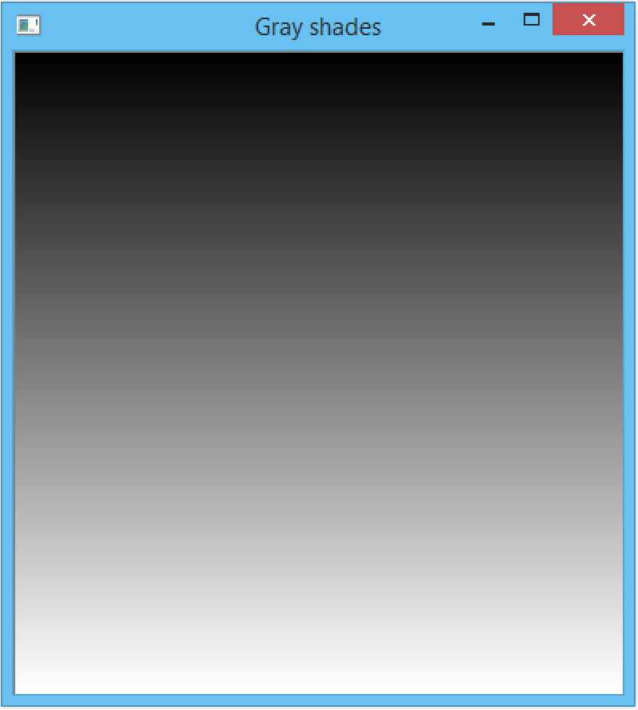
Exercise 1
create a grayscale image with increasing intensities (from black to white) along the vertical direction
both 8-bit and 16-bit versions
both easy/slow and hard/fast versions
also measure the time elapsed
solution in /exercises/access-grayscale-pixels.cpp

Slide 20
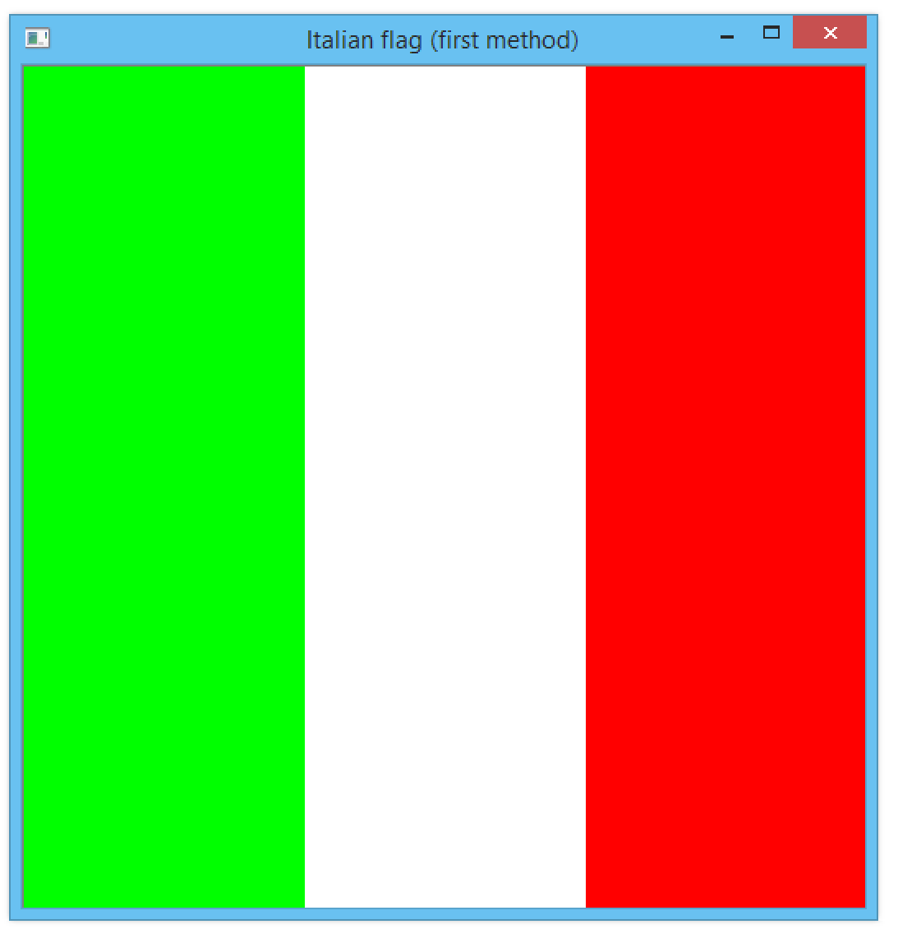
Exercise 2
create a color image resembling the Italian national flag using different methods:
multi-channel pixel access (easy and hard)
split/merge with row/column ROI selection
multi-channel with rectangular ROI selection
solution in /exercises/access-color-pixels.cpp

Slide 21
Images I/O

Slide 22
Read images
cv::Mat aImg = cv::imread(const std::string & path, int flags=1)
loads an image from the specified file and returns it
if the image cannot be read, an empty matrix is returned (that's why we check the aImg.data member)
supported file formats:
.bmp, .dib (Windows bitmaps)
.jpeg, .jpg, .jpe, .jp2 (JPEG/ JPEG 2000)
.png (Portable Network Graphics)
.pbm, .pgm, .ppm (Portable image formats)
.tiff, .tif (TIFF files)

Slide 23
Read images
cv::Mat aImg = cv::imread(const std::string & path, int flags=1)
images are not read 'as they are'
grayscale images are automatically converted to color images
16-bit images are automatically converted to 8-bit
can we avoid this?
yes, by providing the flag CV_LOAD_IMAGE_UNCHANGED
there are also other flags which can be combined using the bitwise or operator |
CV_LOAD_IMAGE_GRAYSCALE loads image as grayscale
CV_LOAD_IMAGE_COLOR loads image as color
CV_LOAD_IMAGE_ANYDEPTH do not apply bitdepth conversion
CV_LOAD_IMAGE_ANYCOLOR do not apply color/grayscale conversion

Slide 24
Write images
cv::imwrite(const std::string & path, cv::Mat aImg)
the file format is inferred from the file extension present in path
the file format should support the pixel type used
for instance, .bmp does not support grayscale images (!)
a good choice that always works is .tif or .png
only 8/16 bit grayscale and BGR color images are supported
floating-type images cannot be saved using the OpenCV function
AIA's library contains a ucas::imwrite function (built on top of the OpenCV's one) that does support even float-type images, using the home-made .cvmat file format
there also is a ucas::imread function to read both OpenCV and .cvmat images

Slide 25
Basic UI

Slide 26
Windows
void cv::namedWindow(const std::string& winname)
void cv::destroyWindow(const std::string& winname)
void cv::updateWindow(const std::string& winname)
creates/destroys/updates a window with the given name
waits for delay milliseconds or for a key event infinitely (when delay=0)
useful to keep a window opened until the user presses a key
moves the given window at the provided (x,y) position
resizes the given window to the specified size
int cv::waitKey(int delay=0)
void cv::moveWindow(const string& winname, int x, int y)
void cv::resizeWindow(const string& winname, int width, int height)

Slide 27
Trackbar callbacks
int cv::createTrackbar(const string& trackbarname, const string& winname, int* value, int count, TrackbarCallback onChange=0)
creates a trackbar with the given name on top of the given window
value is the pointer to the variable to be updated upon user interaction
count is the maximal position of the slider (the minimum is always 0)
onChange is the function to be called every time the slider changes position
the function should have prototype
where pos is the trackbar position and userdata is additional data to be provided to the callback (rarely used, not in this neither in the AIA classes)
we will make an example shortly (see Exercises 4 and 5)
void aTrackbarCallback(int pos, void* userdata)

Slide 28
Mouse callbacks
void cv::setMouseCallback(const string& winname, MouseCallback onMouse)
set mouse handler for the specified window
onMouse is the pointer to the function to be called every time a mouse event is triggered
the function should have prototype
where event is the mouse event id
and x and y are the mouse position when the event occurred
we will make an example shortly (see Exercise 3)
void aMouseCallback(int event, int x, int y, int, void* userdata)
EVENT_MOUSEMOVE =0,
EVENT_LBUTTONDOWN =1,
EVENT_RBUTTONDOWN =2,
EVENT_MBUTTONDOWN =3,
EVENT_LBUTTONUP =4,
EVENT_RBUTTONUP =5,
EVENT_MBUTTONUP =6,
EVENT_LBUTTONDBLCLK =7,
EVENT_RBUTTONDBLCLK =8,
EVENT_MBUTTONDBLCLK =9

Slide 29
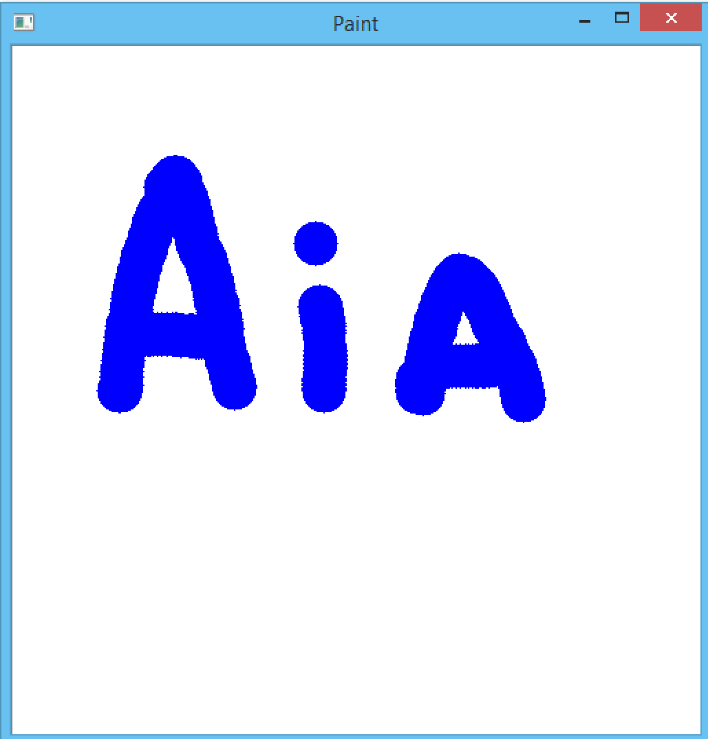
Exercise 3
create a Paint app with basic features
pencil (left-mouse-button)
eraser (right-mouse-button)
solution in /exercises/paint-ui.cpp

Slide 30
Drawing Functions

Slide 31
Drawing functions (1/2)
void cv::line(cv::Mat& img, cv::Point pt1, cv::Point pt2, const cv::Scalar& color, int thickness=1, int lineType=8)
draws a line on top of img between pt1 and pt2 with the given color and thickness
lineType = 8 or 4 (8- or 4-connected line), or =CV_AA (antialiased)
the equivalent function to draw an arrow is cv::arrowedLine()
draws a circle on top of img centered at center with the given color and radius
thickness is the contour thickness, or CV_FILLED=-1 to fill the contour
draws the rectangle rec on top of img with the given color and thickness
void cv::circle(cv::Mat& img, cv::Point center, int radius, const cv::Scalar& color, int thickness=1)
void cv::rectangle(cv::Mat& img, cv::Rect rec, ... color, int thickness=1)

Slide 32
Drawing functions (2/2)
void cv::ellipse(cv::Mat& img, cv::RotatedRect box, ... color, int thickness=1)
draws the ellipse box on top of img with the given color and thickness
a cv::RotatedRect object has members .center, .width, .height , .angle
draws a text string at org (botto-left corner)
fontFace can be FONT_HERSHEY_SIMPLEX, FONT_HERSHEY_PLAIN, ...
fontScale is the font scale factor
void cv::putText(cv::Mat& img, const string& text, cv::Point org, int fontFace, double fontScale, cv::Scalar color, int thickness=1)

Slide 33
Point operators (operations done pixel-wise)

Slide 34
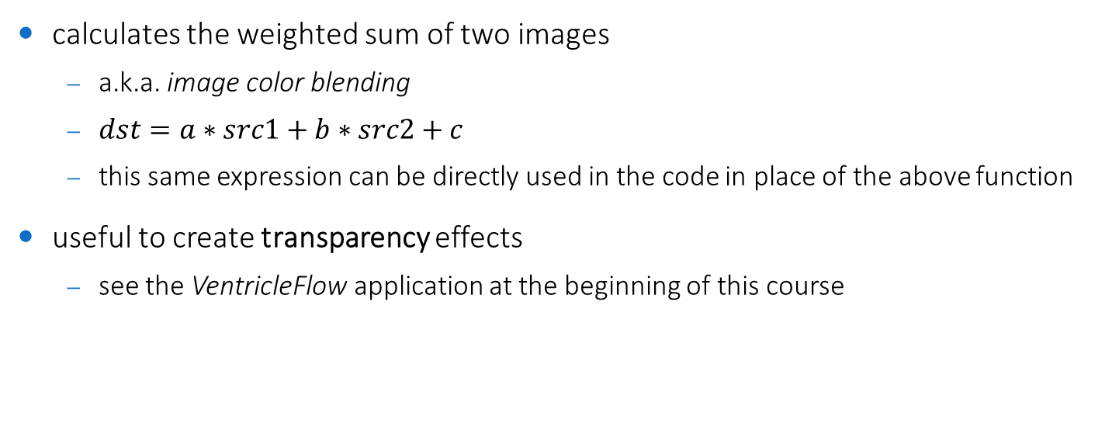
cv::addWeighted
cv::addWeighted(cv::Mat src1, double a, cv::Mat src2, double b, double c, cv::Mat dst)
calculates the weighted sum of two images
a.k.a. image color blending
$dst=a∗src1+b∗src2+c$
this same expression can be directly used in the code in place of the above function
useful to create transparency effects
see the VentricleFlow application at the beginning of this course

Slide 35
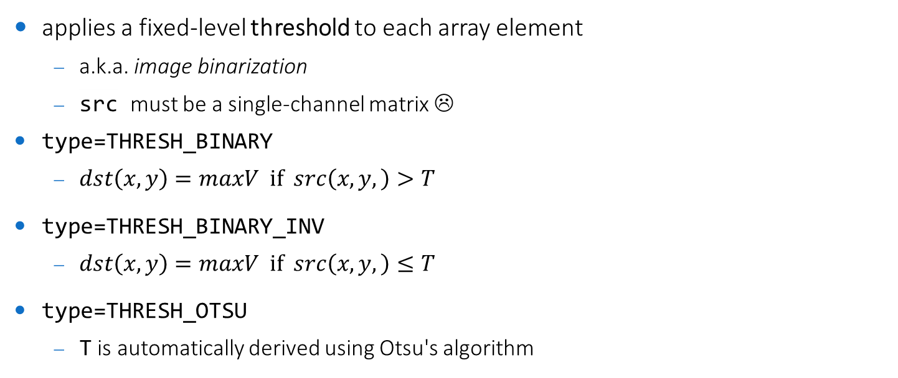
cv::threshold
cv::threshold(cv::Mat src, cv::Mat dst, double T, double maxV, int type)
applies a fixed-level threshold to each array element
a.k.a. image binarization
src must be a single-channel matrix ☹
type=THRESH_BINARY
$dst\left(x,y\right)=maxV if src\left(x,y,\right)>T$
type=THRESH_BINARY_INV
$dst\left(x,y\right)=maxV if src\left(x,y,\right)≤T$
type=THRESH_OTSU
T is automatically derived using Otsu's algorithm

Slide 36
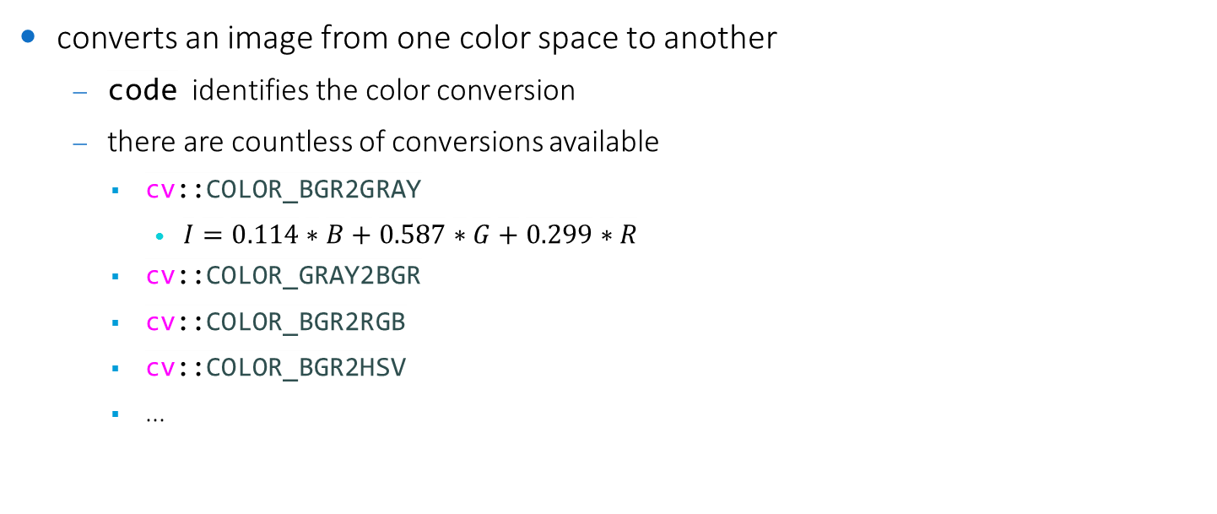
Color conversion
void cv::cvtColor(cv::Mat src, cv::Mat dst, int code)
converts an image from one color space to another
code identifies the color conversion
there are countless of conversions available
cv::COLOR_BGR2GRAY
$I=0.114∗B+0.587∗G+0.299∗R$
cv::COLOR_GRAY2BGR
cv::COLOR_BGR2RGB
cv::COLOR_BGR2HSV
...

Slide 37
Arithmetic operations
logarithm
void cv::log(cv::Mat src, cv::Mat dst)
power
void cv::pow(cv::Mat src, double power, cv::Mat dst)
+, -, /, * are available as C++ overloaded operators

Slide 38
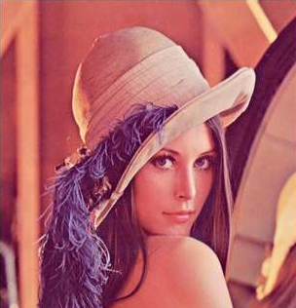
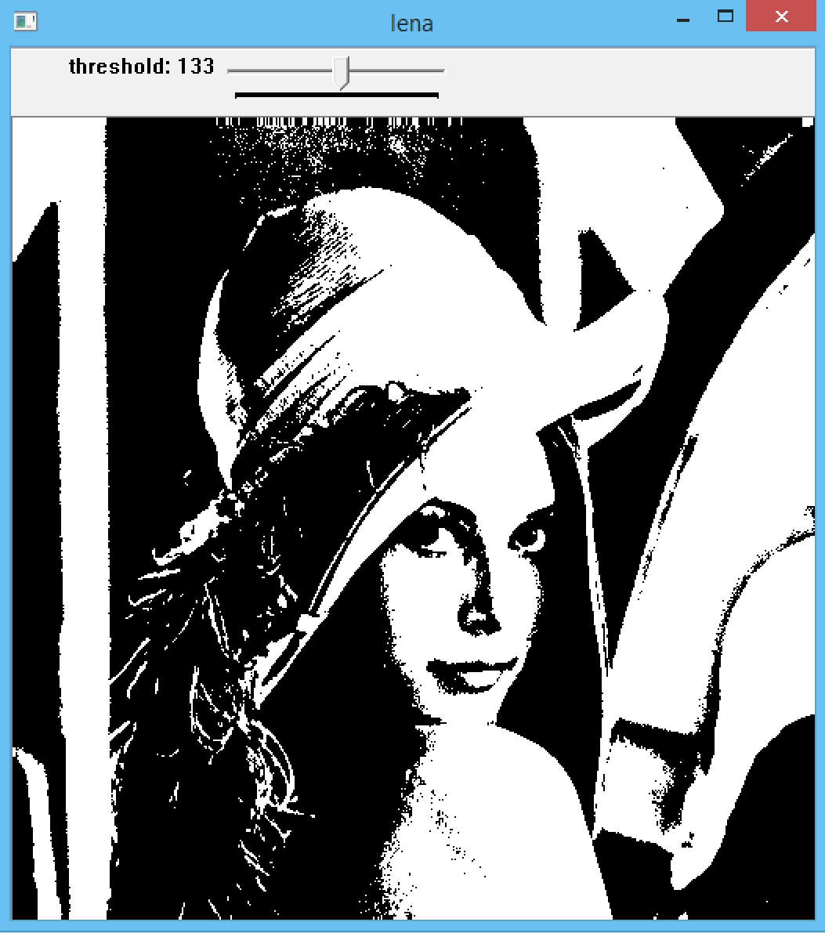
Exercise 4
create a simple UI to interactively threshold an input image
1 trackbar with values in 0-255
real-time update of the thresholded image
solution in /exercises/threshold-ui.cpp

Slide 39
Local operators (operations done in a neighborhood)

Slide 40
Convolution
void cv::filter2D(cv::Mat src, cv::Mat dst, int ddepth, cv::Mat kernel)
convolves an image with the given kernel
ddepth is the OpenCV pixel type of dst (-1 if it is the same of src)
choose this appropriately (better if it is CV_32F) to avoid precision issues
kernel must be a single-channel floating point matrix
under the hood, it performs correlation, not convolution
if the kernel is not symmetric (very rare), this is important
the kernel should be flipped using cv::flip

Slide 41

Gaussian filtering
void cv::GaussianBlur(cv::Mat src, cv::Mat dst, cv::Size ksize, double sX, double sY=0)
convolves an image with a Gaussian kernel
ksize is the kernel dimension, if we provide cv::Size(0,0) then it is automatically calculated from sX and sY so as to contain most of the Gaussian profile
sX and sY are the standard deviation along x- and y-axis, respectively
if sY=0, it is set to the same value as sX
if both are 0, they are automatically calculated from ksize by:
$$σ = 0.3∗((ksize−1)∗0.5 − 1) + 0.8$$

Slide 42
Median filtering
void cv::medianBlur(cv::Mat src, cv::Mat dst, cv::Size ksize)
blurs (different from convolves) an image using the Median filter
ksize is the filter dimension (must be odd)
remember this is a nonlinear operation, thus the larger the filter size, the slower the processing

Slide 43
Bilateral filtering
void cv::bilateralFilter(cv::Mat src, cv::Mat dst, int d, double sigmaColor, double sigmaSpace)
applies the Bilateral filter
d is the diameter of each pixel neighborhood that is used during filtering. If it is non-positive, it is computed from
sigmaColor is the sigma in the color space.
a larger value of the parameter means that farther colors within the pixel neighborhood (see sigmaSpace) will be mixed together, resulting in larger areas of semi-equal color
sigmaSpace is the sigma in the coordinate space.
a larger value of the parameter means that farther pixels will influence each other as long as their colors are close enough (see sigmaColor). When d>0, it specifies the neighborhood size regardless of sigmaSpace. Otherwise, d is proportional to sigmaSpace.

Slide 44
Non-local means filtering
void cv::fastNlMeansDenoising(cv::Mat src, cv::Mat dst)
void cv::fastNlMeansDenoisingColored(cv::Mat src, cv::Mat dst)
applies the Non-local means filter
a widely used denoising filter
fast
faster than the Bilateral filter
easy to set up
easier to set up than the Bilateral filter
see online documentation for parameters (h, templateWindowSize, searchWindowSize) info
all parameters have 100% working default values, thus they could be omitted and should only be used for fine-tuning of the denoising

Slide 45


Derivatives (1/2)
void cv::Sobel(cv::Mat src, cv::Mat dst, int ddepth, int dx, int dy)
calculates the first-order derivatives
dx and dy control the order of the derivative along the corresponding axis
dx=1 and dy=0 for first-order derivative along x-axis (horizontal)
dx=0 and dy=1 for first-order derivative along y-axis (vertical)
...also mixed (!) and higher-order (!) derivatives are supported (extended Sobel operators)
void cv::Laplacian(cv::Mat src, cv::Mat dst, int ddepth)
calculates the Laplacian of the given image by convolving the image with
what if we want to use the better-rotation-invariant Laplacian kernel ?
define your own kernel, and perform cv::filter2D
$$\left[\begin{matrix}0 & 1 & 0 \\ 1 & −4 & 1 \\ 0 & 1 & 0\end{matrix}\right]$$
$$\left[\begin{matrix}1 & 1 & 1 \\ 1 & −8 & 1 \\ 1 & 1 & 1\end{matrix}\right]$$

Slide 46
Derivatives (2/2)
void cartToPolar(cv::Mat x, cv::Mat y, cv::Mat mag, cv::Mat ang, bool degrees=false)
utility function to get element-wise magnitude and phase from x (horizontal) and y (vertical) vector components
useful to calculate the gradient magnitude and phase from the horizontal and vertical gradient components (= Sobel derivatives along the corresponding axes)
useful to calculate the velocity magnitude and angle from the displacements between two adjacent frames in an image sequence
see the VentricleFlow application at the beginning of this course
specified versions:
void magnitude(cv::Mat x, cv::Mat y, cv::Mat mag)
void phase(cv::Mat x, cv::Mat y, cv::Mat ang, bool degrees=false)

Slide 47
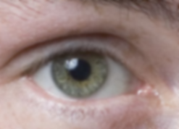
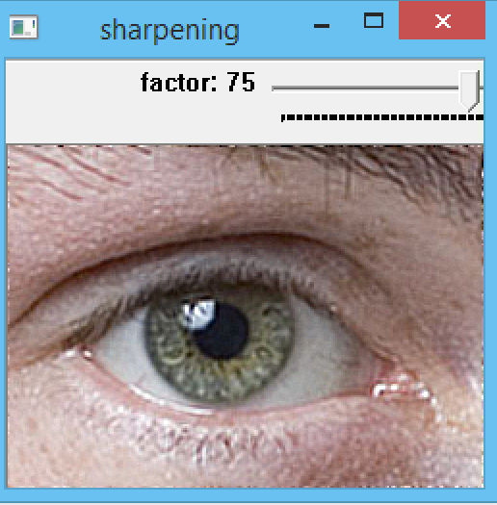
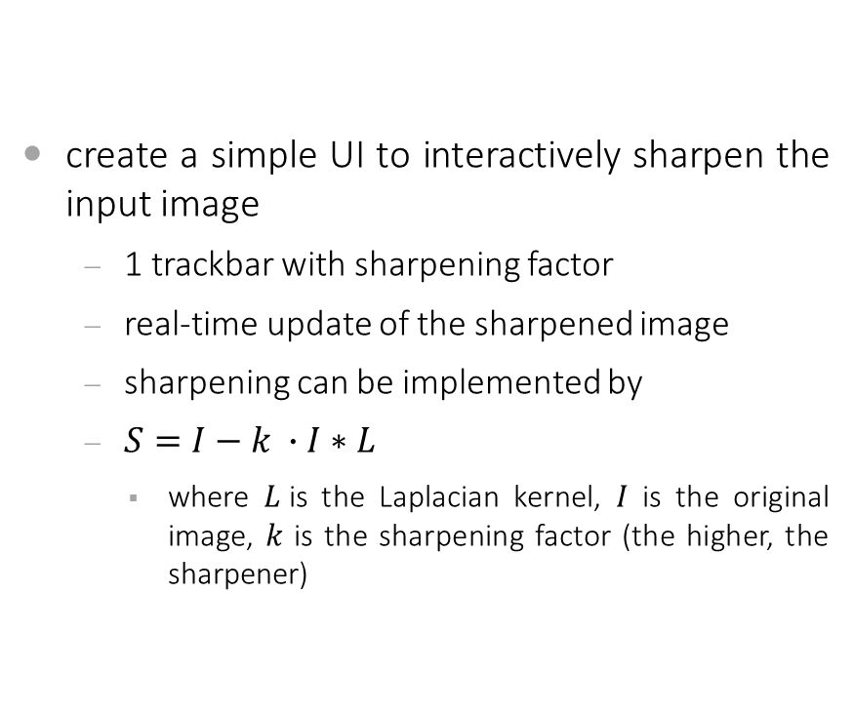
Exercise 5
create a simple UI to interactively sharpen the input image
1 trackbar with sharpening factor
real-time update of the sharpened image
sharpening can be implemented by
$S=I−k ∙I∗L$
where $L$is the Laplacian kernel, $I$ is the original image, $k$ is the sharpening factor (the higher, the sharpener)
solution in /exercises/sharpen-ui.cpp

Slide 48
Global operators (operations done on the whole image)

Slide 49
cv::countNonZero
int countNonZero(cv::Mat src)
returns the number of non-zero elements
src must be a single-channel matrix ☹
useful to check whether an image has changed during an iterative process and/or whether two images contain identical values
countNonZero(cv::abs(img1-img2)) will yield 0 only if the two images are identical
cv::abs(cv::Mat mat) calculates the absolute value for each matrix element

Slide 50
cv::minMaxLoc
void cv::minMaxLoc(cv::Mat src, double* minV, double* maxV=0, cv::Point* minL=0, cv::Point* maxLoc=0, cv::Mat mask=noArray())
finds the global minimum and maximum
minimum and maximum values are stored in minV and maxV, and should be passed by reference ☹
example:
useful to infer the true bitdepth of the image
see ucas::imdepth_detect(const cv::Mat & img)
double minV, maxV;
cv::minMaxLoc(aMat, &minV, &maxV);

Slide 51
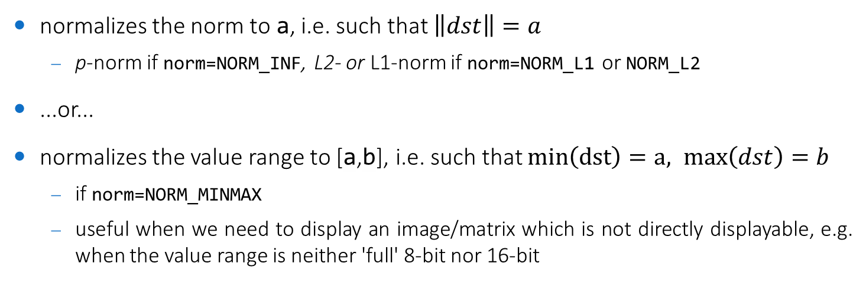
cv::normalize
void normalize(cv::Mat src, cv::Mat dst, double a=1, double b=0, int
norm=NORM_L2, int dtype=-1, cv::Mat mask=noArray())
normalizes the norm to a, i.e. such that $\left\|dst\right\|=a$
p-norm if norm=NORM_INF, L2- or L1-norm if norm=NORM_L1 or NORM_L2
...or...
normalizes the value range to [a,b], i.e. such that $min\left(dst\right)=a, max\left(dst\right)=b$
if norm=NORM_MINMAX
useful when we need to display an image/matrix which is not directly displayable, e.g. when the value range is neither 'full' 8-bit nor 16-bit

Slide 52
Other
geometric transformations
void cv::warpAffine(cv::Mat src, cv::Mat dst, cv::Mat T, cv::Size dsize, int flags=INTER_LINEAR)
void cv::warpPerspective(cv::Mat src, cv::Mat dst, cv::Mat T, cv::Size dsize, int flags=INTER_LINEAR)
void cv::resize(cv::Mat src, cv::Mat dst, cv::Size dsize, double fx=0, double fy=0, int interp=INTER_LINEAR )
histogram equalization
void cv::equalizeHist(cv::Mat src, cv::Mat dst)
segmentation, feature extraction, ...
see Advanced Image Analysis classes

Slide 53
Binary image processing

Slide 54
Image Binarization
cv::threshold(cv::Mat src, cv::Mat dst, double T, double maxV, int type)
we have already seen it as a point operator
in addition, you find in the ucas:: namespace several methods for automatic computation of the threshold T based on the image histogram
int ucas::getMeanThreshold(const std::vector<int> & data)
int ucas::getMinErrorIThreshold(const std::vector<int> & data)
int ucas::getIsoDataAutoThreshold(const std::vector<int> & data)
int ucas::getTriangleAutoThreshold(const std::vector<int> & data)
int ucas::getMaxEntropyAutoThreshold(const std::vector<int> & data)
int ucas::getRenyiEntropyAutoThreshold(const std::vector<int> & data)
int ucas::getYenyAutoThreshold(const std::vector<int> & data)
the histogram can be computed with
std::vector<int> ucas::histogram(const cv::Mat & image)

Slide 55
Connected Components (Contour) Extraction
void findContours(cv::Mat img, <...> & contours, int mode, int method)
extracts connected components (white objects) in a binary image
img must be a 8-bit single channel binary image (nonzero pixels = foreground)
img is modified by the function (!!!)
if you know how connected component labeling works, this should not surprise you ☺
contours will store the array of contours extracted, each contour is an array of points
a suitable (but not the only one) type is std::vector < std::vector <cv::Point> >
mode=CV_RETR_EXTERNAL to get only external contours, CV_RETR_LIST to get all
method: contour approximation method
a "safe" option is to disable approximation by providing CV_CHAIN_APPROX_NONE
contour approximation influences the shape features (barycenter, ...)

Slide 56
Contour drawing
void drawContours(cv::Mat img, <...> contours, int contourIdx, const Scalar& color, int thickness=1, int lineType=8)
draw contour outlines (thickness>0) or filled contours (thickness=CV_FILLED=-1)
contours stores the array of contours, each contour is an array of points
a suitable (but not the only one) type is std::vector < std::vector <cv::Point> >
contourIdx indicates the contour to draw (if negative, all contours are drawn)
it must be less than contours.size()
thickness is the contour thickness, or CV_FILLED=-1 to fill the contour
lineType = 8 or 4 (8- or 4-connected line), or =CV_AA (antialiased)

Slide 57
Operations on contours (1/2)
double contourArea(InputArray contour)
calculates the contour area (does not work for self-intersecting contours)
InputArray can be std::vector <cv::Point>
calculates a contour perimeter (closed = true) or arc length (closed = false)
calculates the up-right bounding rectangle of a point set
a cv::Rect object has members .x, .y, .width, .height
calculates the minimum-area (possibly rotated) rectangle
a cv::RotatedRect object has members .center, .width, .height , .angle
double arcLength(InputArray curve, bool closed)
cv::Rect boundingRect(InputArray points)
cv::RotatedRect minAreaRect(InputArray points)

Slide 58
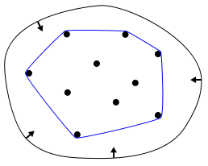
Operations on contours (2/2)
void cv::convexHull(InputArray points, OutputArray hull)
finds the convex hull/envelope of a point set
InputArray and OutputArray can be std::vector <cv::Point>
if dist=false returns +1 if pt is inside contour, 0 if it lies on an edge, -1 otherwise
if dist=true returns the signed distance (+ means inside) to the closest contour point
returns the distance between the two contours in a Hu-moment-based feature space
the closer to zero, the more similar the two contours
various distance metrics available, a suitable choice is method= CV_CONTOURS_MATCH_I1
double pointPolygonTest(InputArray contour, cv::Point2f pt, bool dist)
double matchShapes(InputArray contour1, InputArray contour2, int method)

Slide 59
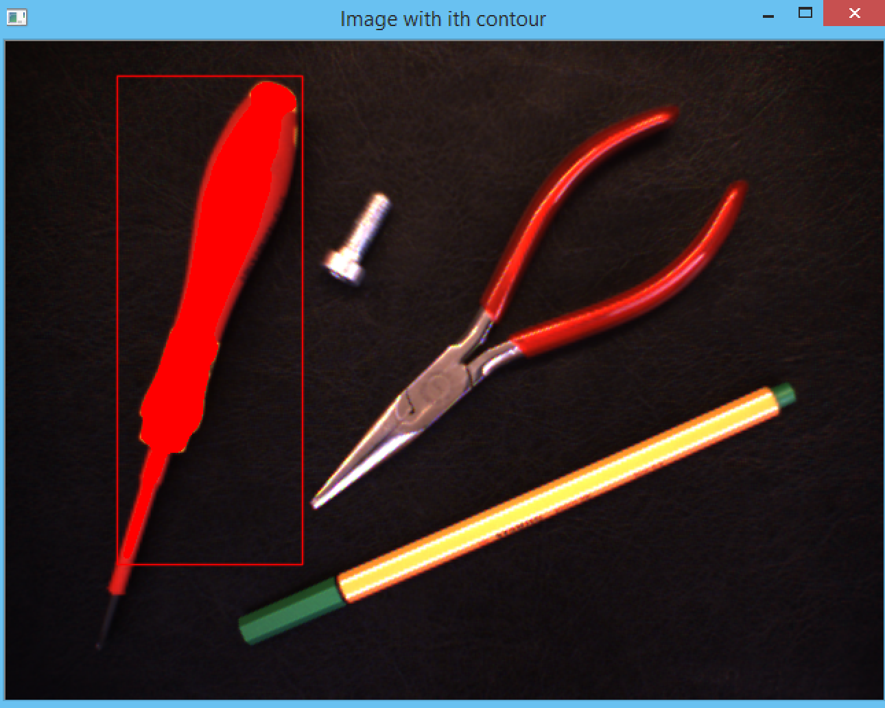
Exercise 6
create a UI for object picking (Magic Wand-like)
binarization with Otsu and/or Triangle
background artifacts removal with local filtering and/or connected components filtering
object selection with mouse callback and point in polygon test
display of selected object with image blending
solution in /exercises/object-picking-ui.cpp

Slide 60
Binary Mathematical Morphology
creating a structuring element
cv::Mat cv::getStructuringElement(int shape, cv::Size ksize)
shape can be cv::MORPH_RECT, cv::MORPH_ELLIPSE or cv::MORPH_CROSS
or create your own cv::Mat with type CV_8U
nonzero elements define the kernel shape
performing a morphology operation
void cv::morphologyEx(cv::Mat src, cv::Mat dst, int op, cv::Mat kernel)
op can be
cv::MORPH_DILATE(dilation)
cv::MORPH_EROSE (erosion)
cv::MORPH_OPEN (opening)
cv::MORPH_CLOSE (closing)
... others we will see in AIA

Slide 61
Exercise 7
modify exercise 6 by performing background artifacts removal with binary morphology
solution in /exercises/object-picking-ui.cpp

